Slide 1
Introduction to SPARK

Slide 2
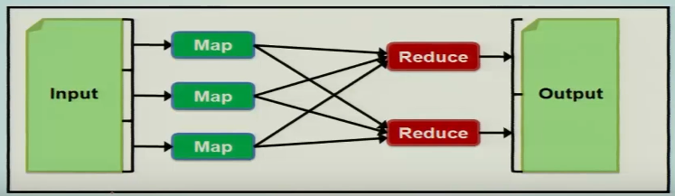
Motivation
MapReduce and its variants have been highly successful in implementing large-scale data-intensive application on commodity clusters.

Slide 3
Motivation
Most current cluster programming models are based on acyclic data flow from stable storage to stable storage
Acyclic data flow is inefficient for applications that are repeatedly reuse working set of data:
Iterative algorithm (Machine learning algorithm, Graphs)
Interactive datamining tools (R, Excel, Python)
With current frameworks, apps reloads data from stable storage on each query

Slide 4
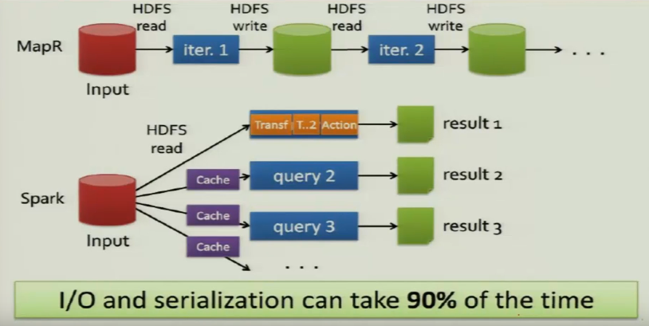
Why SPARK?

Slide 5
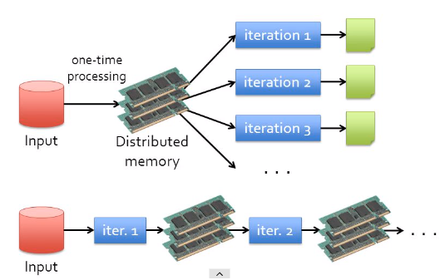
Why Spark?

Slide 6

Spark in Industry
Apache Spark because of it’s amazing features like in-memory processing, polyglot and fast processing are being used by many companies all around the globe for various purposes in various industries:

Slide 7
Spark in Industry
Yahoo
uses Apache Spark for its Machine Learning capabilities to personalize its news, web pages and also for target advertising.
They use Spark with python to find out
what kind of news users are interested to read and
categorizing the news stories to find out what kind of users would be interested in reading each category of news.

Slide 8
Spark in Industry
TripAdvisor
Uses apache spark to provide advice to millions of travelers by comparing hundreds of websites to find the best hotel prices for its customers.
The time taken to read and process the reviews of the hotels in a readable format is done with the help of Apache Spark.
One of the world’s largest e-commerce platform Alibaba runs some of the largest Apache Spark jobs in the world in order to analyze hundreds of petabytes of data on its e-commerce platform.

Slide 9
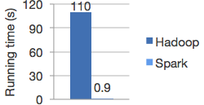
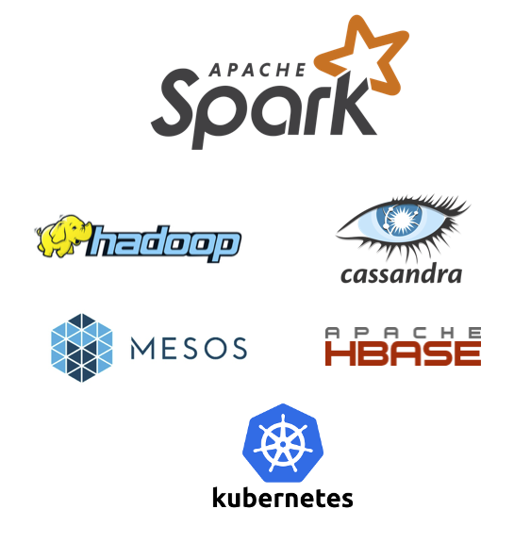
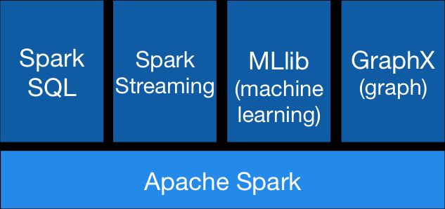
Apache SPARK
Distributed computing framework provide an efficient way of executing operations
Supports for application that reuse a working set of data across multiple parallel operations.
Need to support such applications while retaining the scalability and fault tolerance of MapReduce
To achieve this, Spark introduces an abstraction called resilient distributed datasets (RDDs).
Spark can outperform Hadoop by 10x in iterative machine learning jobs and can be used to interactively query a 39 GB dataset with sub-second response time
Runs Everywhere
runs on Hadoop, Apache Mesos, Kubernetes, standalone, or in the cloud.
It can access diverse data sources.
Speed
Logistic regression in Hadoop and Spark
Generality
Ease of Use
Write applications quickly in Java, Scala, Python, R, and SQL.
Combine SQL, streaming, and complex analytics.

Slide 10
Apache Spark
Apache spark is in memory data processing engine
Developed at UC Berkeley in 2009
APIs in Scala, Python, Java and R
Fault tolerance can be achieved through RDD
Spark deployment mode
Standalone
YARN

Slide 11
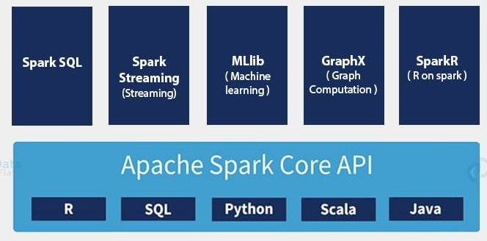
Spark Eco-system

Slide 12
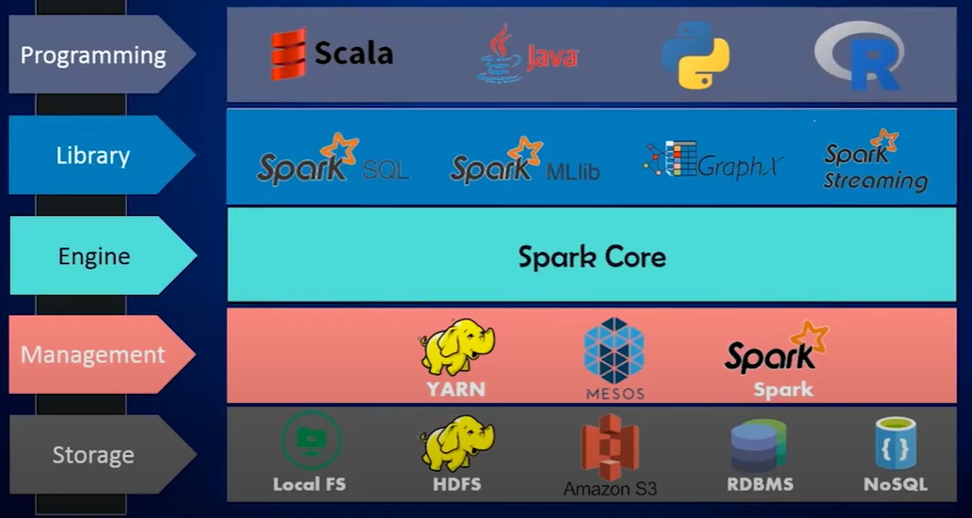
Spark Eco-system

Slide 13
Hadoop MapReduce VS Apache Spark
Hadoop MapReduce | Apache Spark
Fast | 100x faster than MapReduce
Batch Processing | Real-time processing
Stores Data on Disk | Stores data in Memory
Written in Java | Written in Scala, Python, Java, R

Slide 14
Programming model
RDDs are not a general shared memory abstraction
They represent a sweet-spot between expressivity on the one had and scalability and reliability on the other hand, and found well suited for a variety of application.
To use spark, developers write a driver program that implements the high-level control flow of their application and launches various operations in parallel.

Slide 15
Spark provides two main abstractions for parallel programming:
RDDs and parallel operations on these datasets (invoked by passing a function to apply on a dataset).

Slide 16
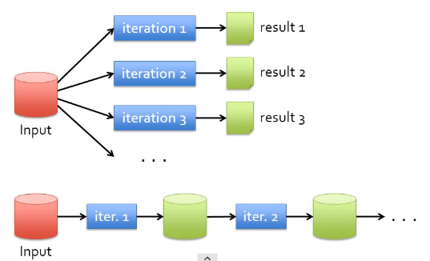
Why RDD?

Slide 17
Scala Programing Language
Ideal language for big data anlaytics and distributed processing
Scala is an object-oriented programming language.
Everything in Scala is an object and any operations you perform is a method call.
Scala is a functional language
It has implemented major functional programming concepts
every computation is treated as a mathematical function which avoids states and mutable data
https://www.analyticsvidhya.com/blog/2017/01/scala/

Slide 18
Scala Programing Language
Scala is a compiler based language
Scala execution very fast if you compare it with Python (which is an interpreted language)
The compiler in Scala works in similar fashion as Java compiler
It gets the source code and generates Java byte-code that can be executed independently on any standard JVM
https://www.tutorialspoint.com/scala/scala_functions.htm

Slide 19
Scala Programing Language
Companies using Scala
It is used by many companies to develop the commercial software.
These are the following notable big companies which are using Scala as a programming alternative.
LinkedIn
Twitter
Foursquare
Netflix
Tumblr
The Guardian
https://www.scala-lang.org/old/node/1658
Precog
Sony
AirBnB
Klout
Apple
https://www.tutorialspoint.com/scala/scala_functions.htm

Slide 20
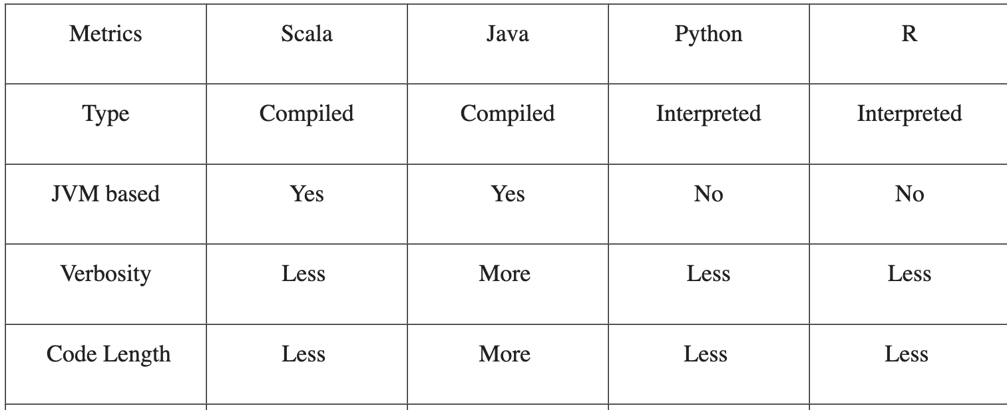
Comparing Scala, Java, Python and R APIs in Apache Spark

Slide 21
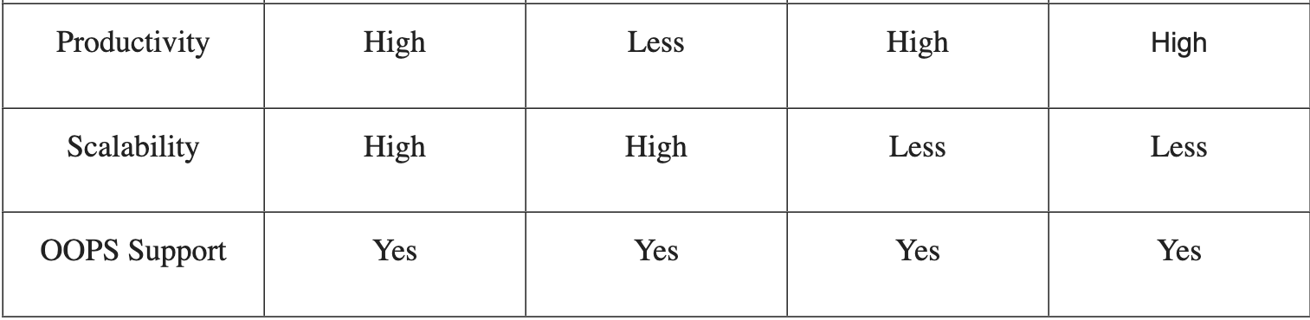
Comparing Scala, Java, Python and R APIs in Apache Spark

Slide 22
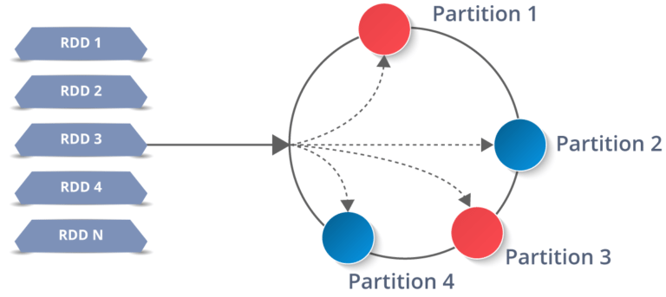
Apache Spark – Resilient Distributed Dataset (RDD)
RDD represents collection of items distributed across many computer nodes that can be manipulated in parallel
A distributed memory abstraction that helps a programmer to perform in-memory computations on large clusters that too in a fault-tolerant manner.

Slide 23
Apache Spark - RDD
Represents a read-only collection of objects partitioned across a set of machines that can be rebuilt if a partition is lost.
If a partition of an RDD is lost, the RDD has enough information about how it was derived from the other RDDs to be able to rebuild just that partition.
Users can explicitly cache an RDD in memory across machines and reuse it in multiple Map-reduce like parallel operations

Slide 24
Apache Spark - RDDs
The elements of an RDD need not exists in physical storage;
Instead, a handle to an RDD contains enough information to compute the RDD starting from data in reliable storage.
Advantages of using Scala for Apache Spark
Working with Scala is more productive than working with Java
Scala is faster than Python and R because it is compiled language
Scala is a functional language

Slide 25
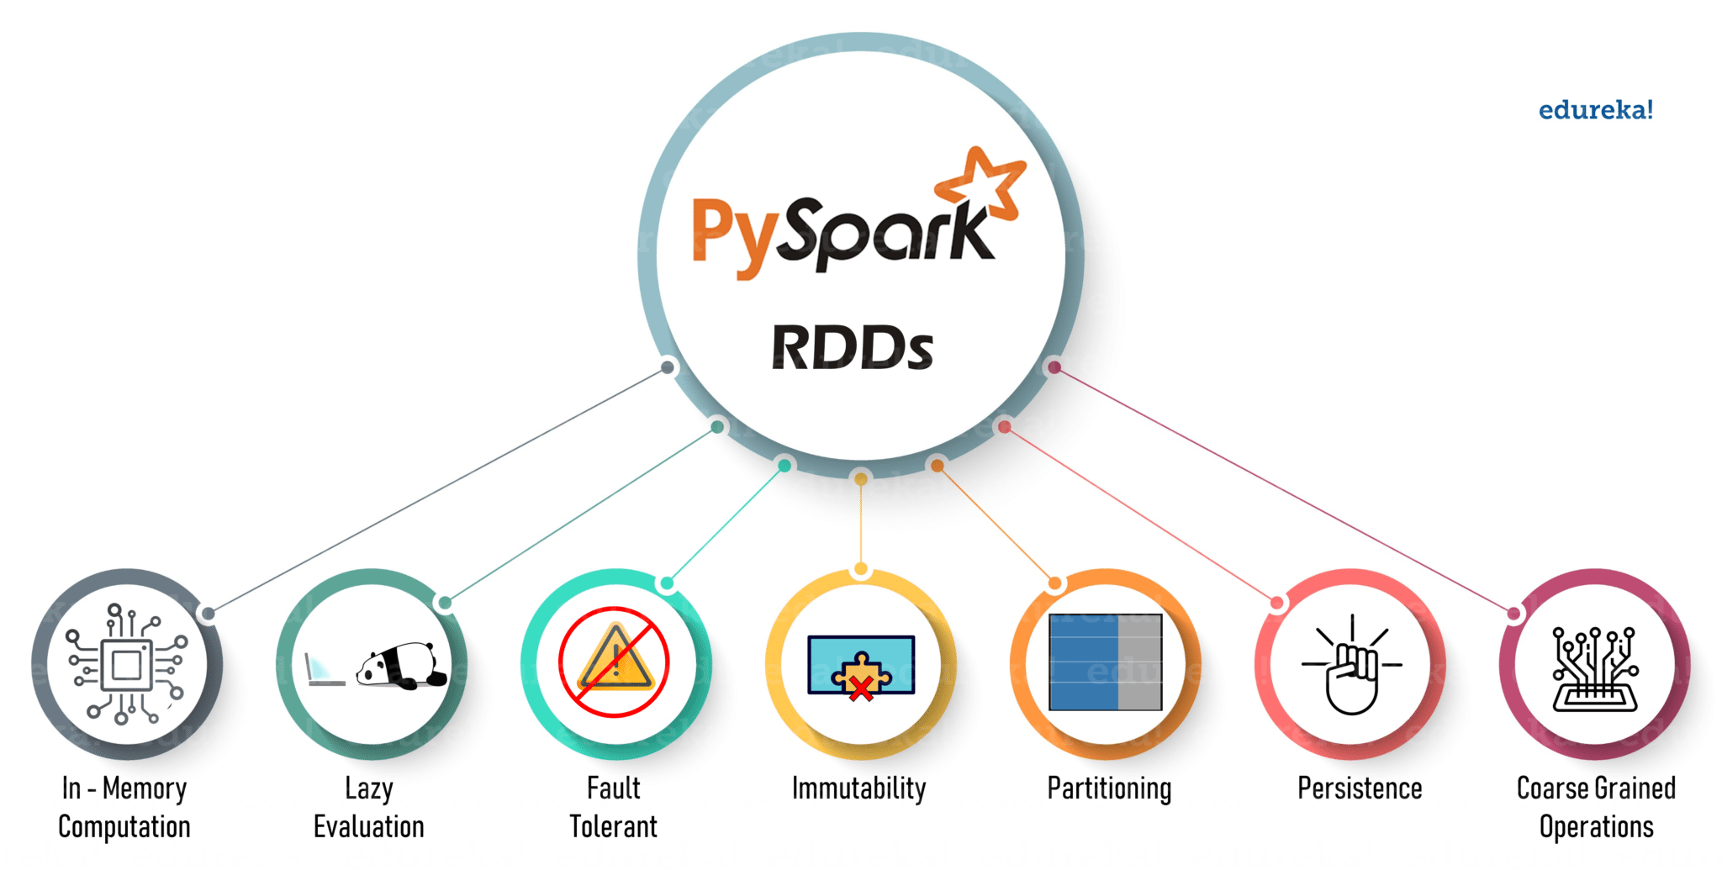
Features of RDDs

Slide 26
Create RDD in SPARK
Way to create RDD
Parallelized collections
From existing RDDs
External Data
or referencing a dataset in an external storage system, such as a shared filesystem, HDFS, HBase, or any data source offering a Hadoop Input Format.

Slide 27
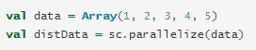
Create RDD in SPARK -Parallelized collection
Parallelized collections are created by calling SparkContext’s parallelize method on an existing collection in your driver program (a Scala Seq).
The elements of the collection are copied to form a distributed dataset that can be operated on in parallel.
For example, here is how to create a parallelized collection holding the numbers 1 to 5:

Slide 28
Create RDD in SPARK - Parallelized collection
Once created, the distributed dataset (distData) can be operated on in parallel.
For example, we might call distData.reduce((a, b) => a + b) to add up the elements of the array.
Number of partitions to cut the dataset into is the important parameter for parallel collections

Slide 29
Parallelized collection
Spark will run one task for each partition of the cluster.
Typically you want 2-4 partitions for each CPU in your cluster.
Spark tries to set the number of partitions automatically based on your cluster.
it can also be done manually by passing it as a second parameter to parallelize (e.g. sc.parallelize(data, 10)).

Slide 30
Create RDDs in SPARK – Hand on Experience
Go to command prompt and type spark-shell
In Scala shell apply operation sc.parallelize(1 to 100, 5).collect()
– it is a method used to create a parallelized collection of RDD
This method here generate numbers between 1 to 100 in five different partitions
collect() is used as an execution/action function

Slide 31
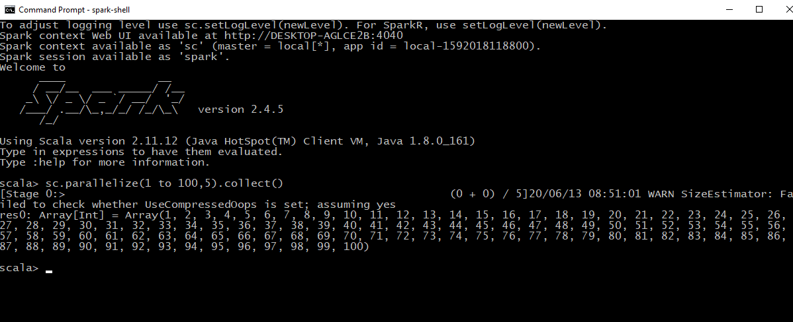

Slide 32
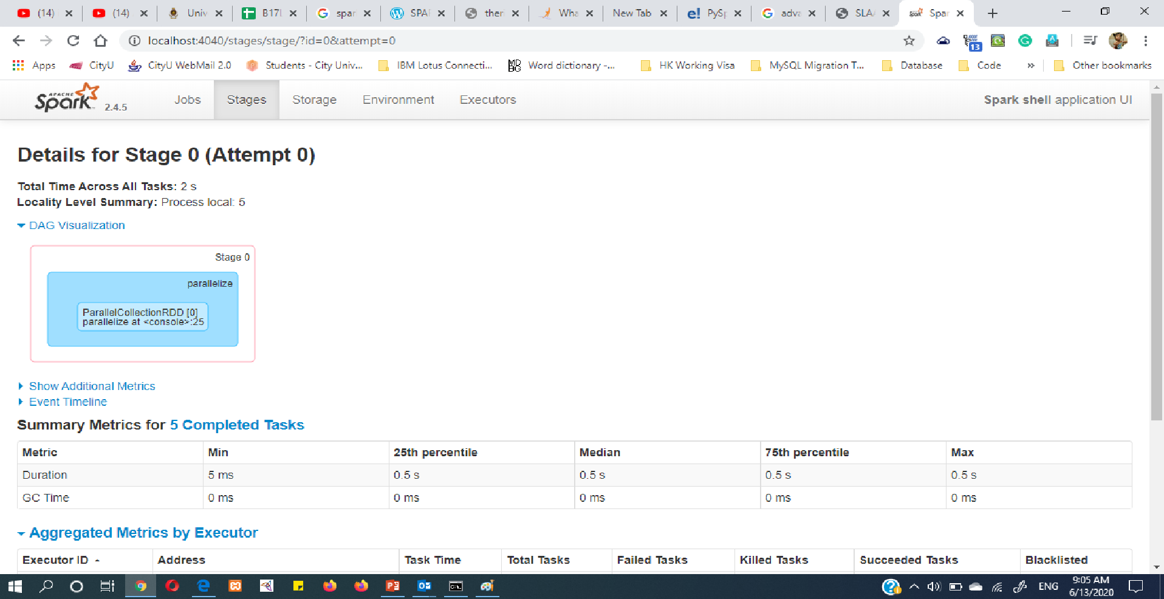
Create RDD in SPARK
Web host for Spark is localhost:4040

Slide 33
Create RDD in SPARK - Using Existing RDDs
Create an array in Scala
scala> var a1 = Array(1,2,3,4,5,6,7,8,9,10)
Parallelize the array a1
scala> var r1 = sc.parallelize(a1)
scala> val newrdd = sc.parallelize(a1.map(data => (data*2)))
newrdd: org.apache.spark.rdd.RDD[Int] = ParallelCollectionRDD[1] at parallelize at <console>:2

Slide 34
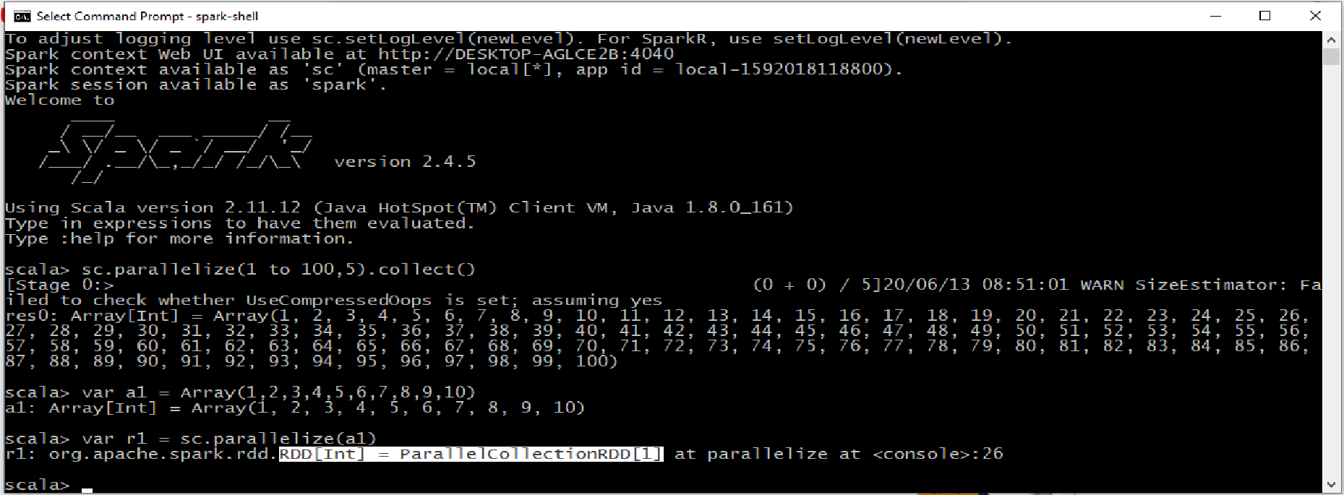

Slide 35
External Datasets
Spark can create distributed datasets from any storage source supported by Hadoop, including your local file system, HDFS, Cassandra, HBase, etc..
Text file RDDs can be created using SparkContext’s textFile method
This method takes an URI for the file (either a local path on the machine) and reads it as a collection of lines.

Slide 36
External Datasets
Once created, distFile can be acted on by dataset operations.
For example,
we can add up the sizes of all the lines using the map and reduce operations as follows:
distFile.map(s => s.length).reduce((a, b) => a + b).

Slide 37
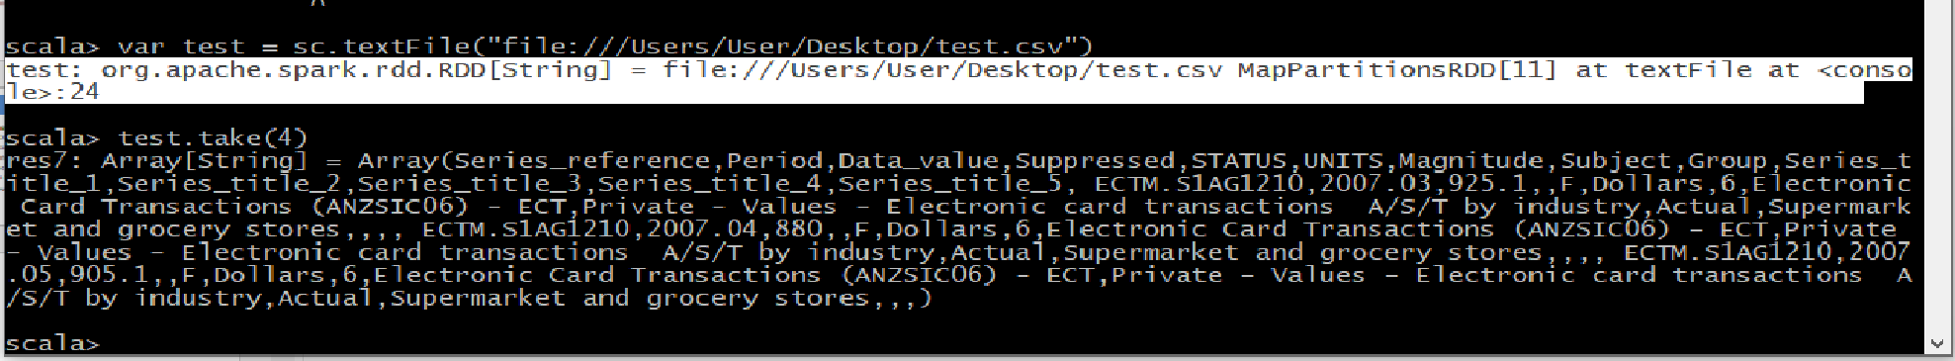
Create RDD in SPARK - External Data
scala> var test = sc.textFile("file:///Users/User/Desktop/test.csv") test: org.apache.spark.rdd.RDD[String] = C:/Users/User/Desktop/test MapPartitionsRDD[3] at textFile at <console>:24
Try with commands
scala> test.first
scala> test.take(4)
scala> test.take(4).foreach(println)

Slide 38
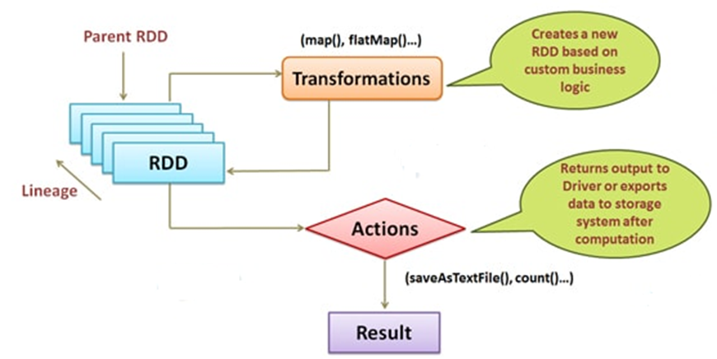
Apache Spark - RDD Operations

Slide 39
Apache Spark - RDD Operations
Transformations: These are the operations which are applied to an RDD to create a new RDD.
Transformations follow the principle of Lazy Evaluations (which means that the execution will not start until an action is triggered).
Let you execute the operations at any time by just calling an action on the data.
Few of the transformations provided by RDDs are:
map
flatMap
filter
distinct
reduceByKey
mapPartitions
sortBy

Slide 40
Apache Spark - RDD Operations
Actions: Actions are the operations which are applied on an RDD to instruct Apache Spark to apply computation and pass the result back to the driver. Few of the actions include:
collect
collectAsMap
reduce
countByKey/countByValue
take
first

Slide 41
Apache Spark - RDD Operations
Creating RDDs with key-value pair
scala> var array1 = Array(('a',2),('b',3))
scala> var array2 = Array(('a',9),('b',7),('c',10))
scala> var a = sc.parallelize(array1)
scala> var b = sc.parallelize(array2)
scala> var c = a.join(b)
scala> c.collect()
[Stage 5:==============> (1 res10: Array[(Char, (Int, Int))] = Array((a,(2,9)), (b,(3,7)))

Slide 42
Apache Spark - RDD Operations
Defining a function in Spark – Scala Shell
scala> def myConcat(word1: String)(word2: String): String = {word1 + word2}
scala> myConcat("beautiful ")("picture")
res13: String = beautiful picture

Slide 43
RDD Operations
All transformations in Spark are lazy, so they do not compute their results right away.
Instead, they just remember the transformations applied to some base dataset (e.g. a file).
The transformations are only computed when an action requires a result to be returned to the driver program.

Slide 44
RDD Operations
This design enables Spark to run more efficiently.
e.g., we can realize that a dataset created through map will be used in a reduce and return only the result of the reduce to the driver, rather than the larger mapped dataset.
By default, each transformed RDD may be recomputed each time you run an action on it.

Slide 45
RDD Operations
However, you may also persist an RDD in memory using the persist (or cache) method
Spark will keep the persist RDD elements around on the cluster for much faster access the next time you query it.
There is also support for persisting RDDs on disk, or replicated across multiple nodes.

Slide 46
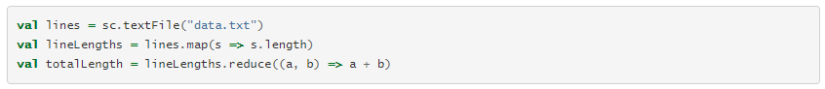
RDD Operations
Consider the simple program below:
Spark does not count the lineLengths due to laziness.
Finally, we run reduce, which is an action.
At this point Spark breaks the computation into tasks to run on separate machines, and each machine runs both its part of the map and a local reduction, returning only its answer to the driver program.

Slide 47
Apache Spark - RDD Operations
Using ReduceByKey transformation to reduce the data

Slide 48
Programming Model
Spark provides two main abstractions for parallel programming:
RDDs and parallel operations on these datasets (invoked by passing a function to apply on a dataset).
There are two ways to create RDDs:
parallelizing an existing collection in your driver program,
or referencing a dataset in an external storage system, such as a shared filesystem, HDFS, HBase, or any data source offering a Hadoop InputFormat.

Slide 49
RDD Operations
RDDs support two types of operations:
transformations, which create a new dataset from an existing one
E.g. map is a transformation that passes each dataset element through a function and returns a new RDD representing the results
actions, which return a value to the driver program after running a computation on the dataset.
E.g. reduce is an action that aggregates all the elements of the RDD using some function and returns the final result to the driver program

Slide 50
Transformation
transformation | Meaning
map(func) | Return a new distributed dataset formed by passing each element of the source through a function func.
filter(func) | Return a new dataset formed by selecting those elements of the source on which func returns true.
flatMap(func) | Similar to map, but each input item can be mapped to 0 or more output items (so func should return a Seq rather than a single item).

Slide 51
Transformation
sample(withReplacement, fraction, seed) | Sample a fraction (fraction) of the data, with or without replacement, using a given random number generator seed.
union(otherDataset) | Return a new dataset that contains the union of the elements in the source dataset and the argument.
intersection(otherDataset) | Return a new RDD that contains the intersection of elements in the source dataset and the argument.
distinct([numPartitions])) | Return a new dataset that contains the distinct elements of the source dataset.
groupByKey([numPartitions]) | When called on a dataset of (K, V) pairs, returns a dataset of (K, Iterable<V>) pairs. Note: If you are grouping in order to perform an aggregation (such as a sum or average) over each key, using reduceByKey or aggregateByKey will yield much better performance. Note: By default, the level of parallelism in the output depends on the number of partitions of the parent RDD. You can pass an optional numPartitions argument to set a different number of tasks.

Slide 52
Transformation
reduceByKey(func, [numPartitions]) | When called on a dataset of (K, V) pairs, returns a dataset of (K, V) pairs where the values for each key are aggregated using the given reduce function func, which must be of type (V, V) => V. Like in groupByKey, the number of reduce tasks is configurable through an optional second argument.
aggregateByKey(zeroValue)(seqOp, combOp, [numPartitions]) | When called on a dataset of (K, V) pairs, returns a dataset of (K, U) pairs where the values for each key are aggregated using the given combine functions and a neutral "zero" value. Allows an aggregated value type that is different than the input value type, while avoiding unnecessary allocations. Like in groupByKey, the number of reduce tasks is configurable through an optional second argument.
sortByKey([ascending], [numPartitions]) | When called on a dataset of (K, V) pairs where K implements Ordered, returns a dataset of (K, V) pairs sorted by keys in ascending or descending order, as specified in the boolean ascending argument.

Slide 53
Actions
Action | Meaning
reduce(func) | Aggregate the elements of the dataset using a function func (which takes two arguments and returns one). The function should be commutative and associative so that it can be computed correctly in parallel.
collect() | Return all the elements of the dataset as an array at the driver program. This is usually useful after a filter or other operation that returns a sufficiently small subset of the data.
count() | Return the number of elements in the dataset.
first() | Return the first element of the dataset (similar to take(1)).
take(n) | Return an array with the first n elements of the dataset.

Slide 54
Actions
Action | Meaning
takeSample(withReplacement, num, [seed]) | Return an array with a random sample of num elements of the dataset, with or without replacement, optionally pre-specifying a random number generator seed.
takeOrdered(n, [ordering]) | Return the first n elements of the RDD using either their natural order or a custom comparator.
saveAsTextFile(path) | Write the elements of the dataset as a text file (or set of text files) in a given directory in the local filesystem, HDFS or any other Hadoop-supported file system. Spark will call toString on each element to convert it to a line of text in the file.

Slide 55
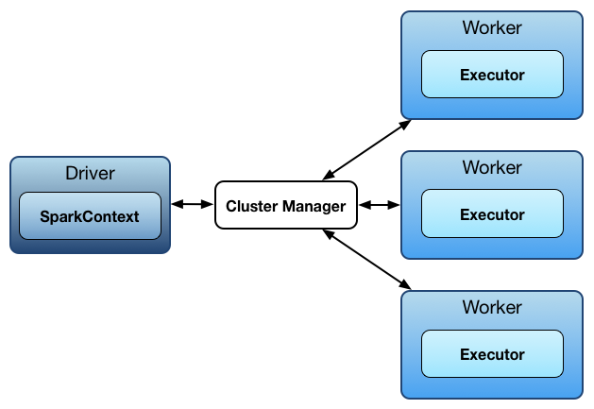
SPARK Architecture
Spark Context
Heart of the Spark application.
Establishes the connection to the Spark Execution Environment.

Slide 56
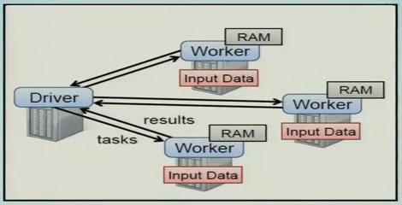
Programming Model
The user’s driver program launches multiple workers, which read data blocks from a distributed file system and can persist computed RDD partitions in memory

Slide 57
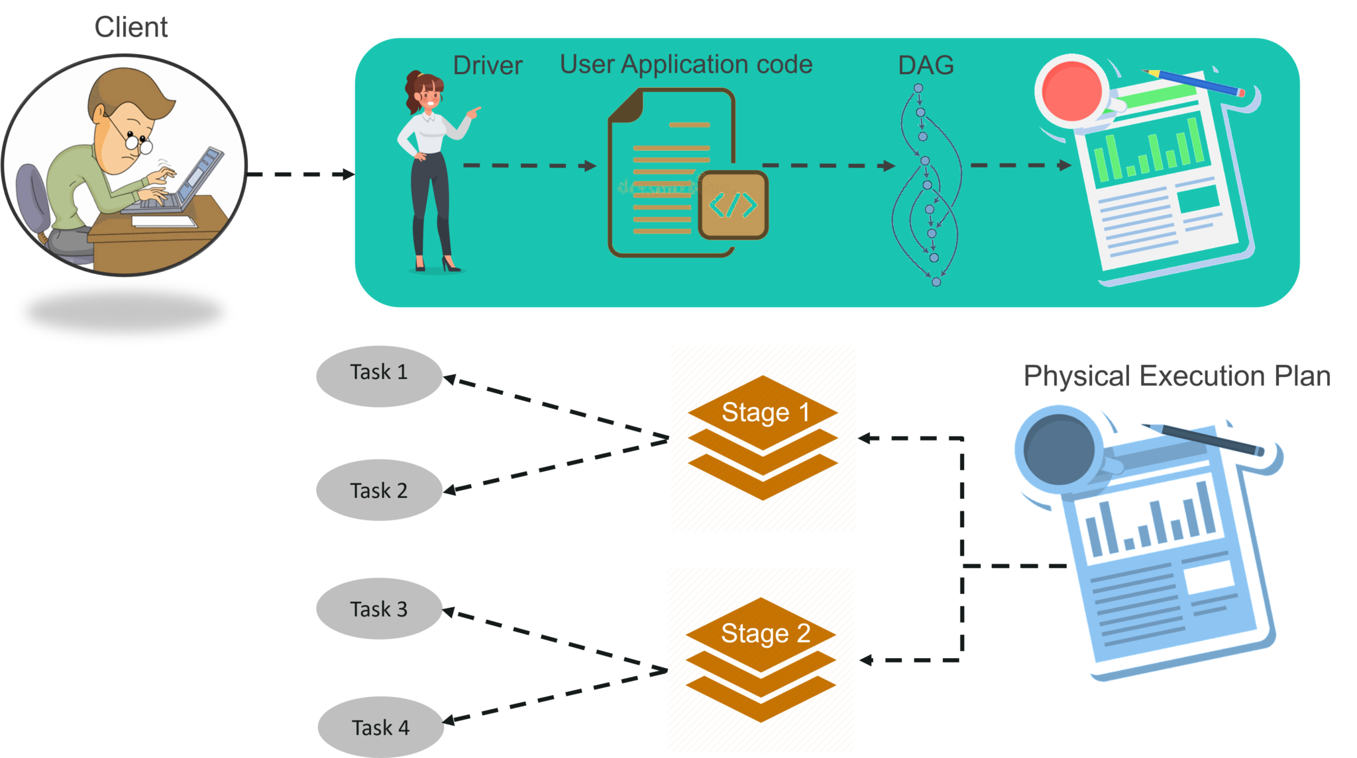
SPARK Architecture

Slide 58
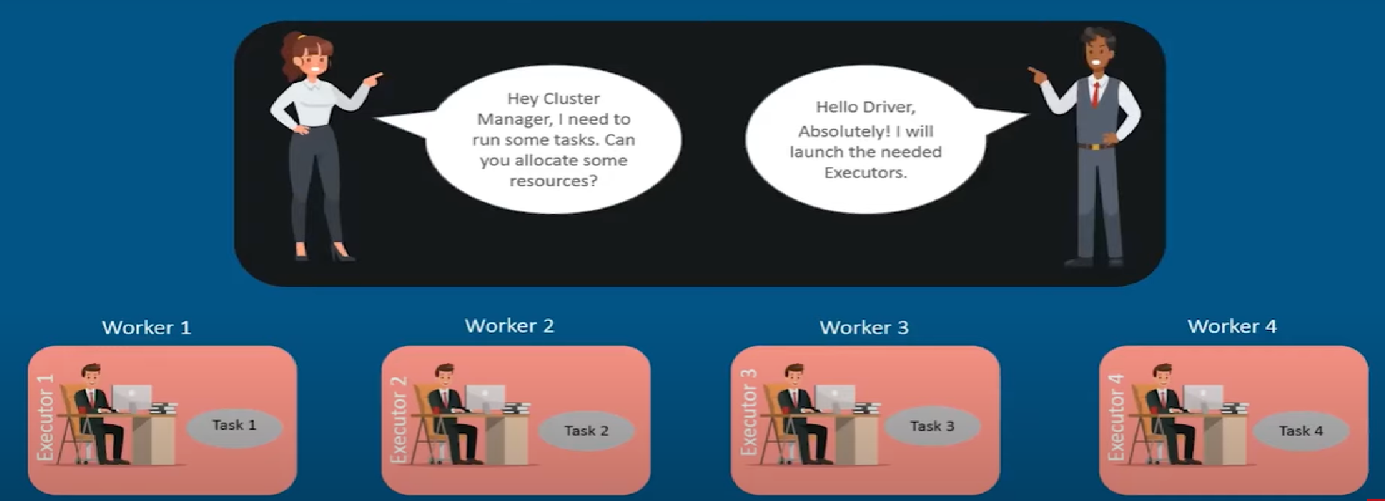
SPARK Architecture

Slide 59
Word Count problem in SPARK
scala> var map = sc.textFile("file:///Users/User/Desktop/testsample.txt").flatMap (line =>line.split(" ")).map(word => (word,1))
scala> var counts = map.reduceByKey(_+_)
scala> counts.saveAsTextFile("file:///Users/User/Desktop/Output9")
scala> map.collect()
scala> counts.collect()
res30: Array[(String, Int)] = Array((hadoop,1), (research,1), (data,1), (science,1), (science,1), (Spark,1), (yarn,1), (This,1), (is,1), (a,1), (text,1), (file,1))
res32: Array[(String, Int)] = Array((is,1), (data,1), (This,1), (science,2), (yarn,1), (file,1), (Spark,1), (hadoop,1), (a,1), (text,1), (research,1))

Slide 60

What is a Data Frame?
Distributed collection of data
Organized in rows under named columns
Filter, Group, Aggregate operations are performed
Used with SparkSQL
Constructed from multiple sources

Slide 61
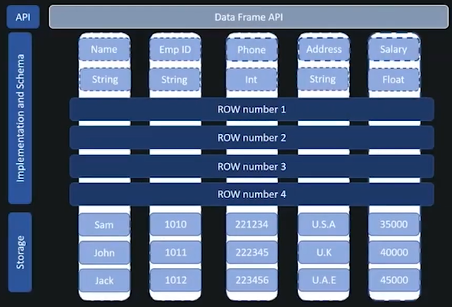
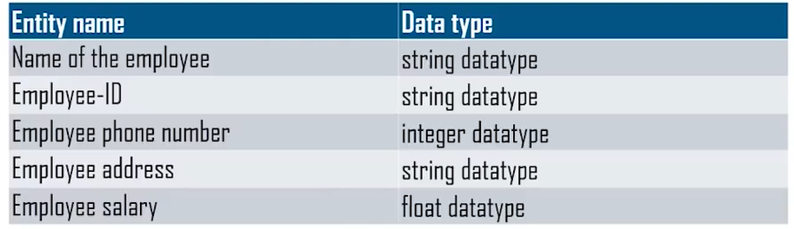

Slide 62

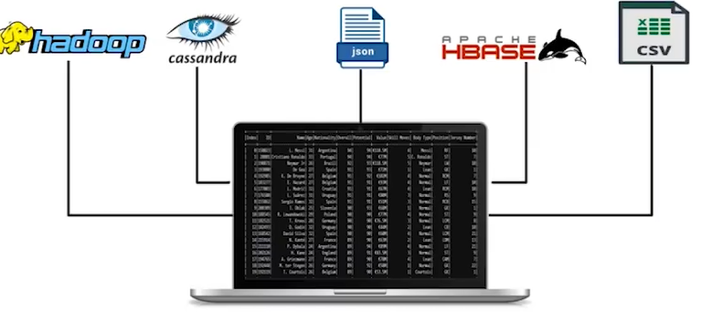
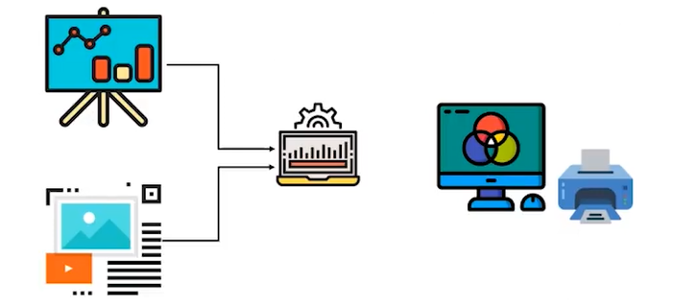
Data Frames features
Support for multiple programming languages
Scala, Java, Python and R
Support for a large variety of sources of data
Processing structured and un-structured data
Process big data with ease
Uses a table format to store the data along with its schema
Slicing and Dicing data
DataFrame APIs support operations like select and filter upon rows and columns.

Slide 63
Data Frames features
Immutability
Data frames are immutable like RDDs
Data cannot be altered. Need to apply simple transformation when alteration is required.
Lazy evaluation
Fault tolerance
Distributed storage

Slide 64
Creating data frames
scala> import org.apache.spark.sql.types._
import org.apache.spark.sql.types._
scala> import org.apache.spark.storage.StorageLevel
import org.apache.spark.storage.StorageLevel
scala> import scala.io.Source
import scala.io.Source
scala> import scala.collection.mutable.HashMap
import scala.collection.mutable.HashMap
scala> import java.io.File
import java.io.File

Slide 65
Creating data frames
scala> import scala.collection.mutable.ListBuffer
import scala.collection.mutable.ListBuffer
scala> import org.apache.spark.util.IntParam
import org.apache.spark.util.IntParam
scala> import org.apache.spark.sql.Row
import org.apache.spark.sql.Row

Slide 66
Creating data frames
scala> import org.apache.spark.sql.types._
import org.apache.spark.sql.types._

Slide 67
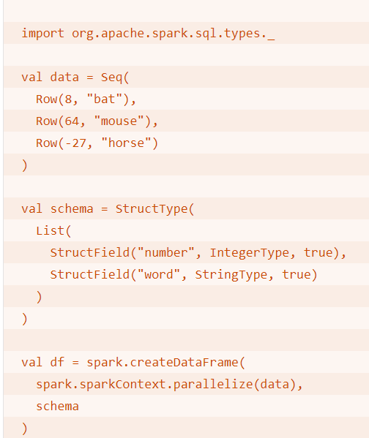
The org.apache.spark.sql.types package must be imported to access StructType, StructField, IntegerType, and StringType.
The StructField above sets the name field to "word", the dataType field to StringType, and the nullable field to true.
StructType objects are instantiated with a List of StructField objects.
The createDataFrame() method takes two arguments:
RDD of the data
The DataFrame schema (a StructType object)

Slide 68
Creating data frame
scala> val Employee = Seq(
Row("Mike", "Robert","Mike09@gmil.com",10000),
Row("Jhon","Milers","Jhon09@gmail.com",20000),
Row("Brett","Lee","Brett09@gmail.com",25000),
Row("Letty","Brown","Brown09@gmail.com",35000))
Employee: Seq[org.apache.spark.sql.Row] = List([Mike,Robert,Mike09@gmil.com,10000], [Jhon,Milers,Jhon09@gmail.com,20000], [Brett,Lee,Brett09@gmail.com,25000], [Letty,Brown,Brown09@gmail.com,35000])

Slide 69
Creating data frame
scala> val EmployeeSchema = List(
StructField("FirstName", StringType,true),
StructField("LastName",StringType, true),
StructField("Mailaddress",StringType,true),
StructField("Salary",IntegerType,true))
EmployeeSchema: List[org.apache.spark.sql.types.StructField] = List(StructField(FirstName,StringType,true), StructField(LastName,StringType,true), StructField(Mailaddress,StringType,true), StructField(Salary,IntegerType,true))

Slide 70
Creating data frame
scala> val EmpDF = spark.createDataFrame(spark.sparkContext.parallelize(Employee),StructType(EmployeeSchema))
EmpDF: org.apache.spark.sql.DataFrame = [FirstName: string, LastName: string ... 2 more fields]

Slide 71
Operations on data frame
scala> EmpDF.show()
+---------+--------+-----------------+------+
|FirstName|LastName| Mailaddress|Salary|
+---------+--------+-----------------+------+
| Mike| Robert| Mike09@gmil.com| 10000|
| Jhon| Milers| Jhon09@gmail.com| 20000|
| Brett| Lee|Brett09@gmail.com| 25000|
| Letty| Brown|Brown09@gmail.com| 35000|
+---------+--------+-----------------+------+

Slide 72
Operations on data frame
scala> EmpDF.printSchema()
root
|-- FirstName: string (nullable = true)
|-- LastName: string (nullable = true)
|-- Mailaddress: string (nullable = true)
|-- Salary: integer (nullable = true)

Slide 73
Operations on data frame
scala> EmpDF.count()
res6: Long = 4
scala> EmpDF.columns.foreach(println)
FirstName
LastName
Mailaddress
Salary

Slide 74
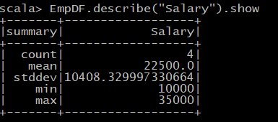
Operations on data frame
scala> EmpDF.describe("Salary").show

Slide 75
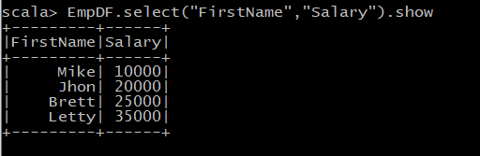
Operations on data frame
scala> EmpDF.select("FirstName","Salary").show

Slide 76
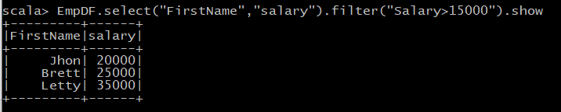
Operations on data frame
scala> EmpDF.select("FirstName","salary").filter("Salary>15000").show

